Slide 1


AI AGENTS TEMPLATES, PROMPT ENGINEERING, & PRE-BUILT AI AGENTS
By Dr. Ryan Ahmed

Slide 2

Prompt Engineering 101
Prompt engineering is the practice of designing and optimizing text input to generative AI models to obtain desired responses.
It is the art of communicating with a generative AI model.
“Recommend a book.”
High-quality prompts guide the AI model to generate better outputs.
“Recommend a fiction book.”
© All rights reserved for Dr. Ryan Ahmed @Stemplicity Inc.
“Recommend a historical fiction book set in World War II.”

Slide 3
Prompt Components
Context: background knowledge to help the model understand the domain.
Assume that you are an expert financial analyst
Instruction: A clear statement of the desired goal.
Context
Classify the following text as positive, neutral, or negative
Input Data: The data the model needs to process to produce output.
Instruction
Text: “Apple stock increased by 2% in today's trading session”
© All rights reserved for Dr. Ryan Ahmed @Stemplicity Inc.
Output Indicator: tells the model the format of the output.
Input Data
Sentiment:
Output Indicator

Slide 4
Top 5 Prompting Tips
Force The Model to Avoid Hallucination
“Don’t hallucinate, ground your results in the provided data. If data is missing, say ‘not enough info’ instead of guessing.”
Ask for reasoning, not just answers:
“explain your steps” or “show the calculation before the result” to build trust and transparency.
Add constraints & boundaries:
Word limits, style guides, or examples help the model aim correctly. “Explain in 3 bullet points, max 15 words each.”
Iterate and refine
The first draft is rarely the final. Treat prompts like a conversation; tweak wording, add detail, narrow scope until the output clicks.
Anchor with examples (Few Shot Prompting):
Show the AI what “good” looks like. A sample answer, tone, or structure is worth paragraphs of instructions.
© All rights reserved for Dr. Ryan Ahmed @Stemplicity Inc.

Slide 5
PROMPT ENGINEERING TECHNIQUES

Slide 6

Prompt Engineering Techniques: Zero-Shot Prompting
Zero-shot prompting refers to the ability of a generative AI model to generate responses without being provided with any prior examples.
The model relies on its broad general knowledge learned from its training data to complete the task.
User prompt:
“Tell me the sentiment of the following headline and categorize it as either positive, negative or neutral:
New airline between Seattle and San Francisco offers a great opportunity for both passengers and investors.”
Generative AI model
© All rights reserved for Dr. Ryan Ahmed @Stemplicity Inc.
Output:
Positive

Slide 7
Prompt Engineering Techniques: Few-Shot Prompting
Few-shot prompting (in-context learning) involves providing a few example pairs of input and desired output to the generative AI model to guide its responses.
User prompt:
“Tell me the sentiment of the following. Here are some examples:
Apple stock declined 2% today
Answer: Negative
Tesla stock gained 5% after successful self-driving demo
Answer: Positive
OpenAI expanded its userbase to 100 million
Answer:”
Generative AI model
Output:
Positive
© All rights reserved for Dr. Ryan Ahmed @Stemplicity Inc.

Slide 8
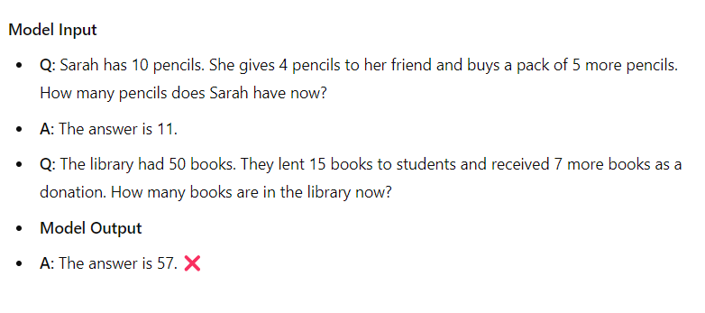
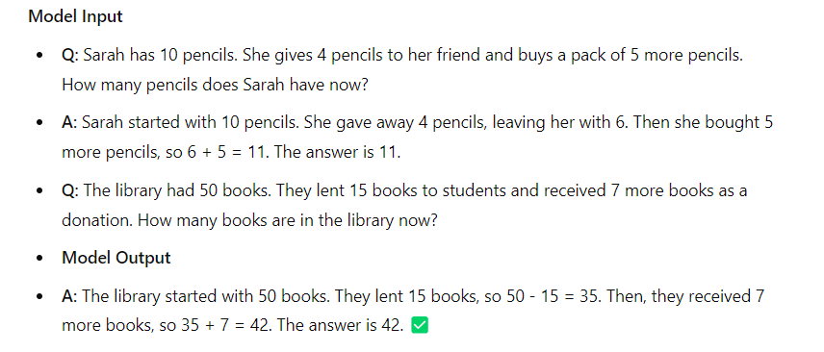
Prompt Engineering Techniques: Chain-of-Thought
Chain-of-thought prompting is a technique that improves the reasoning abilities of AI models by breaking down complex questions or tasks into smaller manageable steps.
It mimics how humans' reason and solve problems by systematically breaking down the decision-making process.
Standard Prompting
Chain-of-thought Prompting
© All rights reserved for Dr. Ryan Ahmed @Stemplicity Inc.

Slide 9
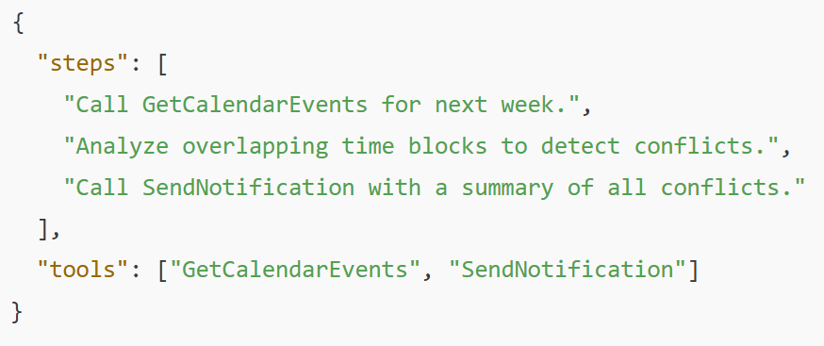
Prompt Engineering Techniques: ReAct (Reason + Act)
ReAct (Reason + Act) Prompting is a technique that boosts an AI model’s problem-solving accuracy by making it do two things:
  Reason: think through the problem step-by-step, analyze information, and plan.
  Act: take a specific action based on that reasoning, such as generating an answer, extracting data, or making a decision.
Prompt
Reason: Understand the user request, identify the required subtasks, and choose the tools the agent must use.
Act: Return an action plan with the tool sequence.
User request:
“Find all calendar conflicts for next week and notify me.”
Expected Output
© All rights reserved for Dr. Ryan Ahmed @Stemplicity Inc.
Generative AI model

Slide 10
Thank you!

